Slide 1
Full Stack Application Development
Web Protocols
HTTP
HTTP Request- Response and its structure
Akshaya Ganesan

Slide 2
HTTP Request- Response and its structure

Slide 3
HyperText Transfer Protocol(HTTP)
HTTP is an request-response client-server protocol
HTTP is a stateless protocol.
HTTP is an application-level protocol for distributed, collaborative, hypermedia information systems.

Slide 4
HTTP
Each HTTP communication (request or response) between a browser and a Web server consists of two parts:
The header contains information about the communication.
The body contains the data of the communication (optional).
A header
A body

Slide 5
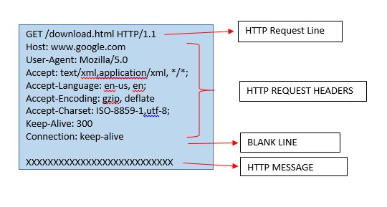
HTTP Request
The general form of an HTTP request is:
HTTP Request Line
Header fields
Blank line
Message body (Optional)

Slide 6

Request Line
The first line of the header is called the request line:
Examples of request line are:
request-method-name /request-URI /HTTP-version
GET /test.html HTTP/1.1
HEAD /query.html HTTP/1.0
POST /index.html HTTP/1.1

Slide 7
HTTP Methods (Verbs)
GET - Fetch a URL
HEAD - Fetch information about a URL
PUT - Store to an URL
POST - Send form data to a URL and get a response back
DELETE - Delete a resource in URL
GET and POST (forms) are commonly used.

Slide 8
Request Headers
The request headers are in the form of name:value pairs. Multiple values, separated by commas, can be specified.
Examples of request headers are:
request-header-name: request-header-value1, request-header-value2, ...
Host: www.xyz.com
Connection: Keep-Alive
Accept: image/gif, image/jpeg, */*
Accept-Language: us-en, fr, cn

Slide 9
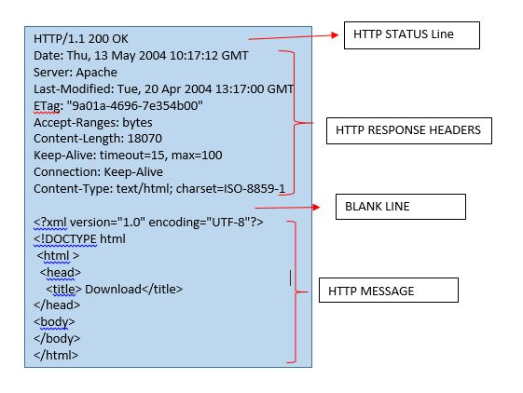
HTTP Response
The general form of an HTTP response is:
Status line
Response header fields
Blank line
Response body

Slide 10
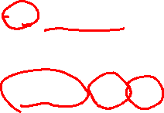
Status Line
The first line is called the status line.
HTTP-version status-code reason-phrase
status-code: a 3-digit number generated by the server to reflect the outcome of the request.
reason-phrase: gives a short explanation to the status code.
Common status code and reason phrase are:
Examples of status line are:
200 OK
403 Forbidden
404 Not Found
500 Internal Server Error
HTTP/1.1 200 OK
HTTP/1.0 404 Not Found
HTTP/1.1 403 Forbidden

Slide 11
STATUS CODE
Status code is a three-digit number; first digit the specifies the general status
=> Informational
=> Success
=> Redirection
=> Client error
=> Server error

Slide 12
Common HTTP Response Status Codes
200 OK Indicates a nonspecific success
201 Created Sent primarily by collections and stores but sometimes also by controllers, to indicate that a new resource has been created
204 No Content Indicates that the body has been intentionally left blank
301 Moved Permanently Indicates that a new permanent URI has been assigned to the client’s requested resource
303 See Other Sent by controllers to return results that it considers optional
401 Unauthorized Sent when the client either provided invalid credentials or forgot to send them

Slide 13
Common HTTP Response Status Codes
402 Forbidden Sent to deny access to a protected resource
404 Not Found Sent when the client tried to interact with a URI that the REST API could not map to a resource
405 Method Not Allowed Sent when the client tried to interact using an unsupported HTTP method
406 Not Acceptable Sent when the client tried to request data in an unsupported media type format
500 Internal Server Error Tells the client that the API is having problems of its own

Slide 14
Response Headers
The response headers are in the form name:value pairs:
Examples of response headers are:
The response message body contains the resource data requested.
response-header-name: response-header-value1, response-header-value2, ...
Content-Type: text/html
Content-Length: 35
Connection: Keep-Alive
Keep-Alive: timeout=15, max=100

Slide 15
HTTP
HTTP Request
HTTP Response

Slide 16
Thank You!

